Slide 1

AALIM MUHAMMED SALEGH COLLEGE OF ENGINEERING DEPARTMENT OF MECHANICAL ENGINEERING
FINAL REVIEW
Date:25-06-2022

Slide 2
PROJECT: DESIGN AND FABRICATION OF SKID PLATE
PROJECT MEMEBERS :
1)N.MOHAMMED BILAL
2)JOGESHWARE RAO
3)F.KHAJA EZZAZUDTHEEN AHAMED
4)A.ARSHAD HASAN
SIGNATURE SIGNATURE
DR.S.RAMKUMAR Mr.T.N JAFFER ALI
HEAD OF THE DEPARTMENT SUPERVISOR
Professor And Head Of The Department, Assistant Professor,

Slide 3
INTRODUCTION:
The idea behind skid plates is simple to understand. These plates work as a protective barrier between your vehicle's base framework and the road underneath. By absorbing the shock of any impact with the road, these skid plates keep your vehicle delicate components safe from being exposed to extensive damage Skid plates are thicker and are made from aluminum or steel. Aluminum skid plates are great when it comes to lightweight materials. They are not as strong as steel and tend to develop holes or rips. Steel skid plates are heavier but stronger than the aluminum. these skid plates act as a protective shield for its undercarriage. This is much like a vehicle which externally covers the engine and its closeby components. But even in this smiliary, there’s a stark difference between a the differen vehicles and its skid plates. A bike offers more cosmetic appeal than a functional use. On the other hand, skid plates serve a very crucial safety need for all types of bikes especially those with a lowered height or off-road usage.

Slide 4
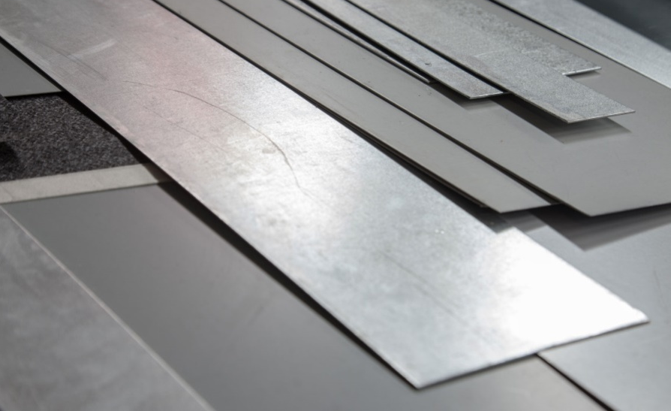
COMPONENTS: STAINLESS STEEL SHEET METAL
The sheet metal is used for
fabrication work.
Sheet metal length 127*76cm
Thickness 2mm

Slide 5
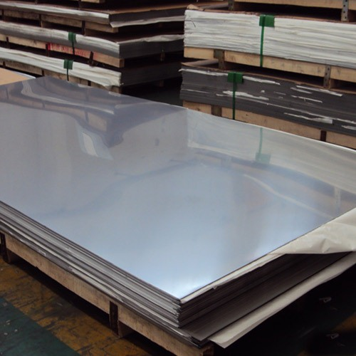
Process:
First process to buy stainless sheet metal with length of 127*76cm and thickness 2mm. Then cut the one part of the sheet metal into the length with 61.5 cm length 25cm breadth with 2mm thickness.
Then bend the sheet metal according to the dimensions Skid plate will be completed by some minor process.Then paint or coat the skid plate with fully furnished .

Slide 6
AUTOCAD 2D DIAGRAM -1

Slide 7
AUTOCAD 2D DIAGRAM -II

Slide 8
AUTOCAD 2D DIAGRAM - III

Slide 9
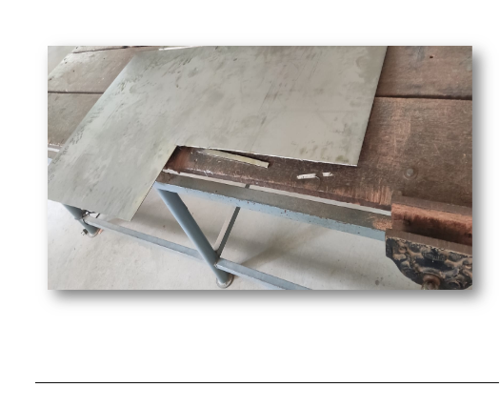
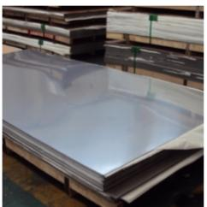
FIGURE NO -I

Slide 10
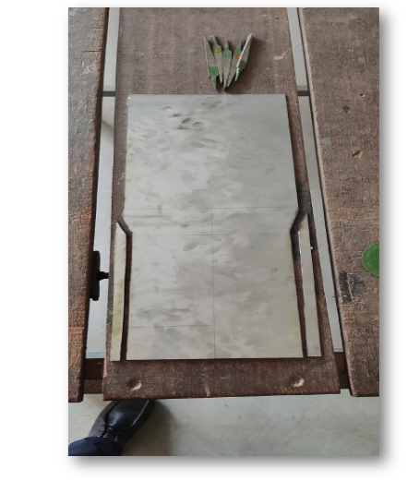
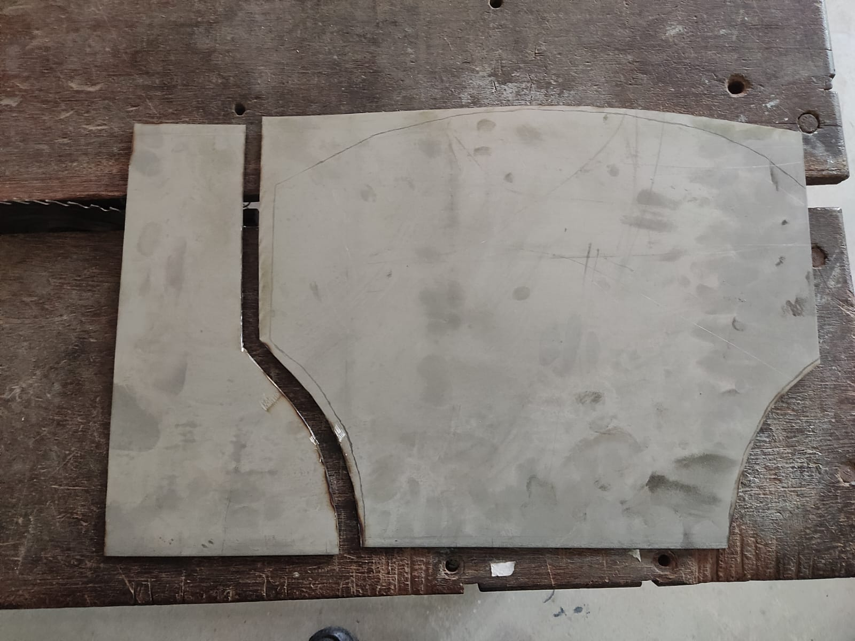
FIGURE NO - II

Slide 11
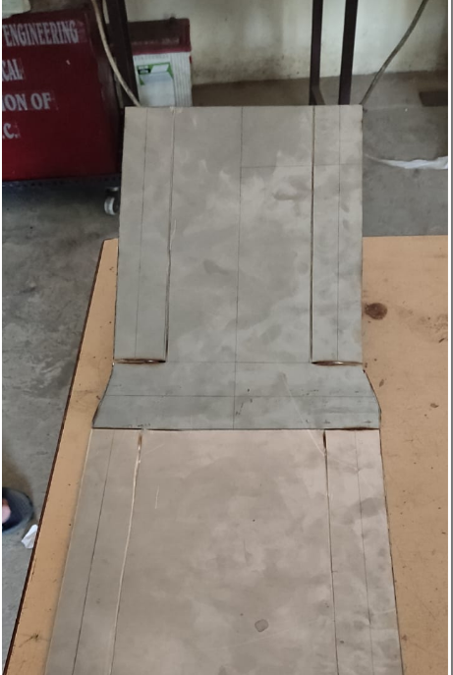
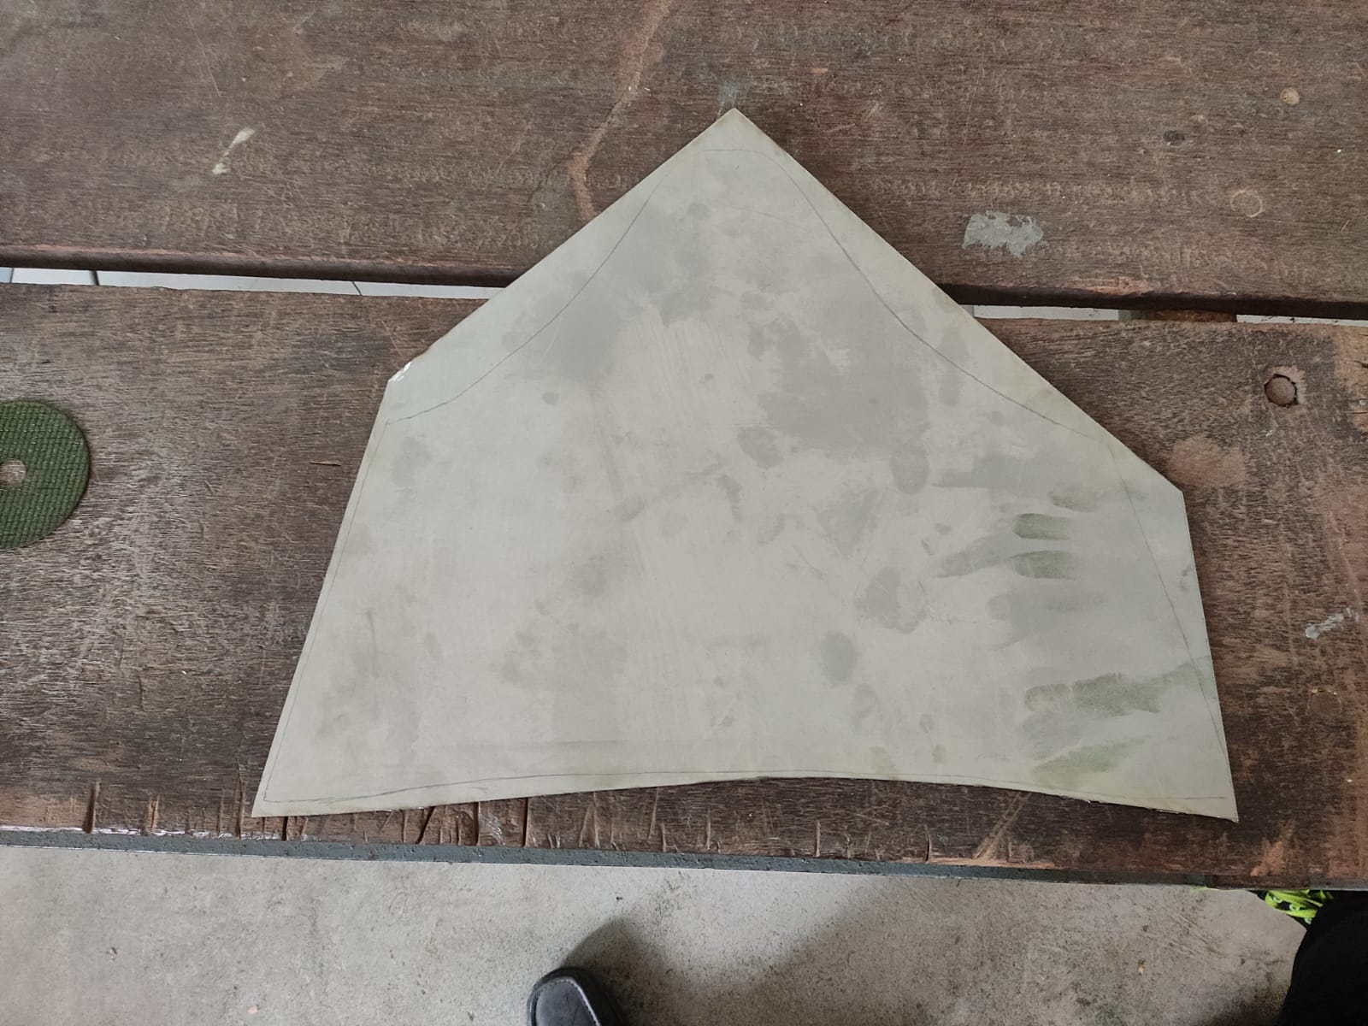
FIGURE NO -III

Slide 12
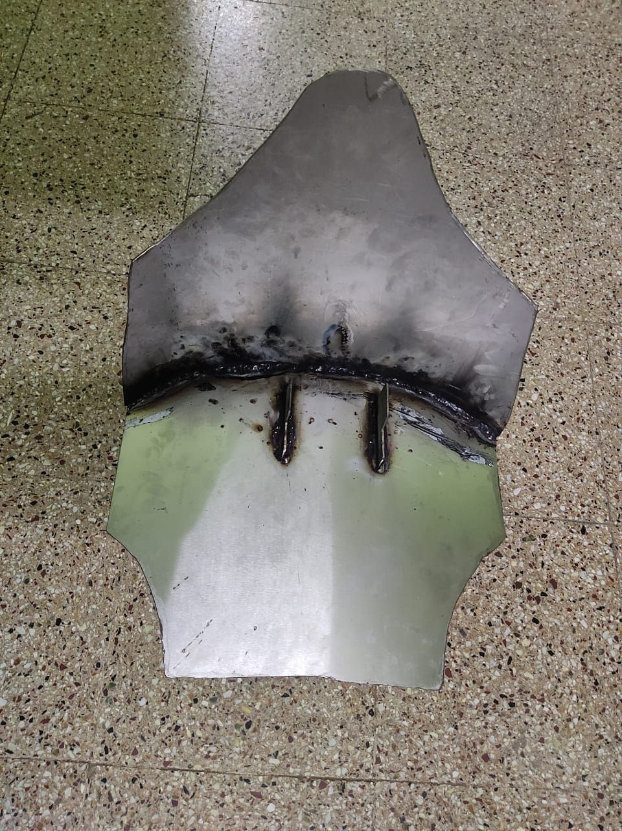
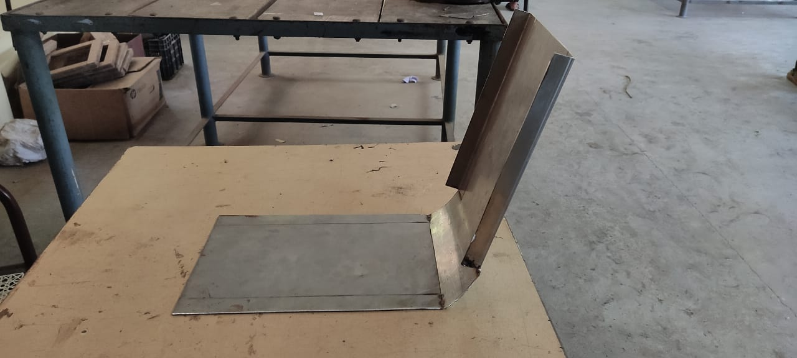
FIGURE NO -IV

Slide 13
COST ESTIMATION:
Stainless sheet metal : 3,500
Welding cost : 250
Bending: 350
Painting : 250
Labour charge : 200
Report cost: 200
Total cost: 4,750

Slide 14
ADVANTAGES AND DISADVANTAGES:
ADVANTAGES:
Increased resistance against any impact or debris found on the road.
It covers the front compartment of the car, so the engine is more protected against dust and dirt.
Longer lifespan compared to skid plates made of plastic or fibre glass.
It protects the frame, motor and linkage on an off-road motorcycle.
DISADVANTAGES:
The material is much heavier compare to aluminium
Cost is higher than normal sheet metal

Slide 15
Conclusion:
SKID PLATE protects the vechile from the damage of the engine.
It also prevent the the silencer and engine in rainy days from the staganent water.
This skid plate is made up of stainless steel and it also can be done in aluminium sheet.
Aluminium is costly than the stainless steel sheet metal

Slide 16
THANK YOU

